Slide 1




Shine a Light on Your
Utility Rights
March 19th, 2026

Slide 2


​
  Understanding utility bills​
​
  Preventing shutoffs on past due electric and gas bills​
  Financial assistance programs
  The New Expanded EAP
​
  Deferred payment agreement​
​
  How to use the NYS Department of Public Service’s complaint process​
What we will talk about today:

Slide 3

What are Utilities?
Utilities provide essential services such as:
Electricity
Water
Heating (natural gas, steam, deliverable fuels)
Telecommunication: Phone, Cable,
Broadband Internet

Slide 4



Types of Utility Provider in NYS
PSC-Regulated Utilities:
Investor-owned companies regulated by the NYS PSC and DPS​ (i.e., Central Hudson)
Municipal/Public Power Authorities:​
Publicly owned entities often operated by local government or authorities. Not regulated by the PSC but by local or state laws.​

Slide 5
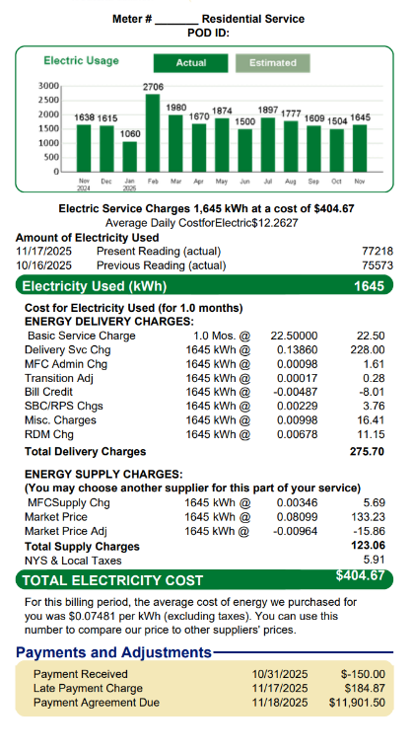
What is on your bill?
Supply Charges​
  Supply charges are not regulated
  Not fixed; considered volatile or variable
  Customers can consider 3rd party suppliers called ESCOs, but PULP cautions their use. Learn more at: NYS Power to Choose website

Slide 6
What is on your bill?
Delivery Charges ​
  The cost to provide you serivces, including the cost of meters, meter readings, customer service, communications, and accounting ​
  Regulated by the PSC and Department
  A rate case must be filed to raise delivery charges.
    Determines what the Basic Service Charge will be
​

Slide 7
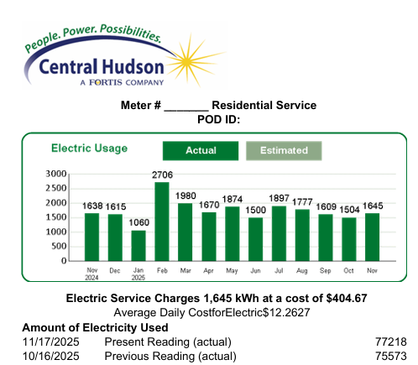
What is on my bill?
1
  Meter Number
  Reading Dates
  Meter Reading
  Total Usage
4
2
3

Slide 8
Understanding Smart Meters
What is a smart meter: Smart meters use radio signals—similar to cell phones
Higher Bills: A spike may reflect more accurate readings. Compare past bills or ask for a meter test if it seems off.
Accuracy: Smart meters reduce estimates, but you can request a manual reading if something looks wrong.
Opt-Out Option: You may decline installation—note that fees could apply.

Slide 9
PAYMENT
1
Pay what you can when you can
COMMUNICATE
How to protect your home from termination?
2
Ask the utility if a shutoff is scheduled
DELAY
3
If a shutoff is scheduled, request a 30-day hold to fix the issue.
ASSISTANCE
4
Seek financial help from local and state agencies: DSS, HRA or charities
PROTECT
Complete a certification if someone in the household has health-related needs.
PULP’s Prevention Tips
5
NEGOTIATE
Ask your utility for a deferred payment plan if one hasn’t been offered.
6
ESCALATE
7
Consider filing an inquiry or complaint with the Department of Public Service.

Slide 10


Termination F.A.Q
When can terminations happen?
When are shutoffs off-limits?
  Utilities cannot terminate until 35 days of missed payment
    Must wait 20 days until payment is past due
    Termination notice must be issues at least 15 days before shutoff
  Monday- Thursday 8AM-4PM
  Fridays and weekends
  Public holidays
  If the company main office is closed
  During the 2-week holiday period at the end of the year
    Cold Weather: Below 32 degrees

Slide 11


Extreme Heat Protections
Utility​ | Shutoff Pause Trigger​
Central Hudson​ | 90°F (as of March 19, 2026)

Slide 12
Household Protections
Medical Certifications
Elderly, Blind, Disabled
Life Supportive Equipment
  Be on official letterhead.
  Include patient’s name, address
  Include provider’s contact info and state license number
  State that loss of utility would worsen the medical condition.
Protection lasts 30 days and can be renewed monthly with updated documentation.
  EBD coding offers extra shutoff protections—but only if all household members are EBD or children
  If denied, submit a medical certification for any vulnerable person
  Medical letters for vulnerable indiviudals can still delay shutoffs without EBD coding
  Customers relying on life-supporting medical devices (e.g., ventilators, dialysis machines, oxygen) receive utility shutoff protections
  Requires medical certification
  Utilities must prioritize restoration and avoid disconnection for certified life support customers
Central Hudson Medical Protection Contacts: Fax: 1-845-486-5676
Notes:
PSL Section 32 Termination of Service

Slide 13
Where to find assistance?
Social Services
Charities/Local
Home Energy Assistance Program (HEAP) (Opens Nov.)
Other HEAP funded grants: ​
Emergency HEAP (Opens Jan.)
Repair and replace (Opens Oct.)​
Cooling Assistance (Opens Spring 2026)
Emergency Energy Assistance
(AKA One- Shot Deal)
Family of New Paltz
Catholic Charities & Other Religious Affiliated
Food Pantries
Community Action Agencies (CAAs)
United Way (211)
Central Hudson’s: Good Neighbor Fund

Slide 14
Monthly Discount Program
What Do You Need to Apply for EAP:
  Name & Account Match: Applicant name must match utility account holder
  Account Number
  Proof of Eligibility: Award letter from a qualifying program
  Must show:
    Recipient’s name
    Program name
    Date (within past 12 months)
Note: Benefit holder can be any household member at the same address
Not eligible? Apply for SNAP or HEAP
Professionally translated to Spanish / NPPF001 / 10.24

Slide 15
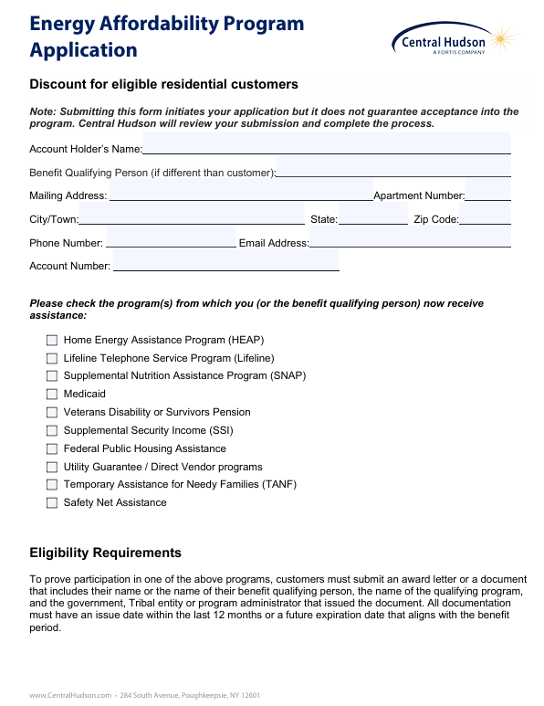
Central Hudson Energy Affordability Program (EAP) Application Example

Slide 16
Program Update: Expanded EAP
The Enhanced Energy Affordability Policy (EEAP) will provide energy bill discounts to gas and electric utility customers below median income.
The program has opened as of January 2026. Application and information is available at https://www.nyeeap.com/program.
What are the differences of EAP and EEAP?
Who does EEAP target?
The EEAP targets those customers below median income who do not qualify for low-income EAPs to achieve the PSC's target six percent energy burden.
The EAP and EEAP provide economic assistance on utility bills to customers with differing income levels.

Slide 17
Income Limits for EEAP
Household size | ConEd & National Grid NYC | National Grid Long Island | Central Hudson and all other NY utilities
1 | $113,400 | $115,450 | $69,477
2 | $129,600 | $131,950 | $90,854
3 | $145,800 | $148,450 | $112,232
4 | $162,000 | $164,900 | $133,609
5 | $175,000 | $178,100 | $154,986
6 | $188,000 | $191,300 | $176,364

Slide 18
Deferred Payment Agreements (DPA)
An agreement to pay for accumalated balances over a period of time
It must be in writing, signed by the customer and a utility representative.
It must be tailored to customer’s financial circumstances.
Note: Ask for a financial statement to have your finances considered
A down payment on arrears may be required.
The lowest agreement is $0 down, $10 per month plus the current bill.
Notes:
PSL Section 37

Slide 19
Department of Public Service
DPS is New York State’s utility oversight agency
Filing an Inquiry or Complaint with DPS: ​
By phone: 1-800-342-3377​
Online: www.dps.ny.gov/complaints​
​
What can they help you with?
  Negotiate Payment Agreements
  Reviewing Medical Certification
  Investigating Billing Disputes
  Handling Service Shutoff Notices
What Is a Rate Case?
The formal process where a utility asks to change customer rates for services.
Who’s Involved?
  Utility Company
  DPS Staff (reviews & recommends)
  Advocates (e.g., PULP)
  The Public (testimony & comments)
Key Steps
Utility files → Public comments→ Parties negotiate → PSC issues final decision
~11-month process

Slide 20
When to Call PULP?
We’re here to help – especially when situations are complex or urgent.
Please make sure that you try these steps first:
1. Gather your documents
2. Call your utility company:
3. Visit your local Public Benefits Office:
4. File an inquiry or complaint with the Department of Public Service (DPS)
Email: info@utilityproject.org
Hotline: (877) 669-2572
Fax: (877) 669-2572

Slide 21
Presenters:
Laurie Wheelock – Executive Director
Follow us @utilityproject on social media!
Email: info@utilityproject.org
Hotline: (877) 669-2572
Fax: (877) 669-2572
194 Washington Ave.
Suite 320
Albany, NY 12210

